Slide 1
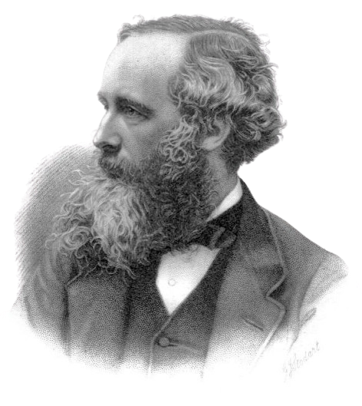
James Clerk Maxwell

Slide 2
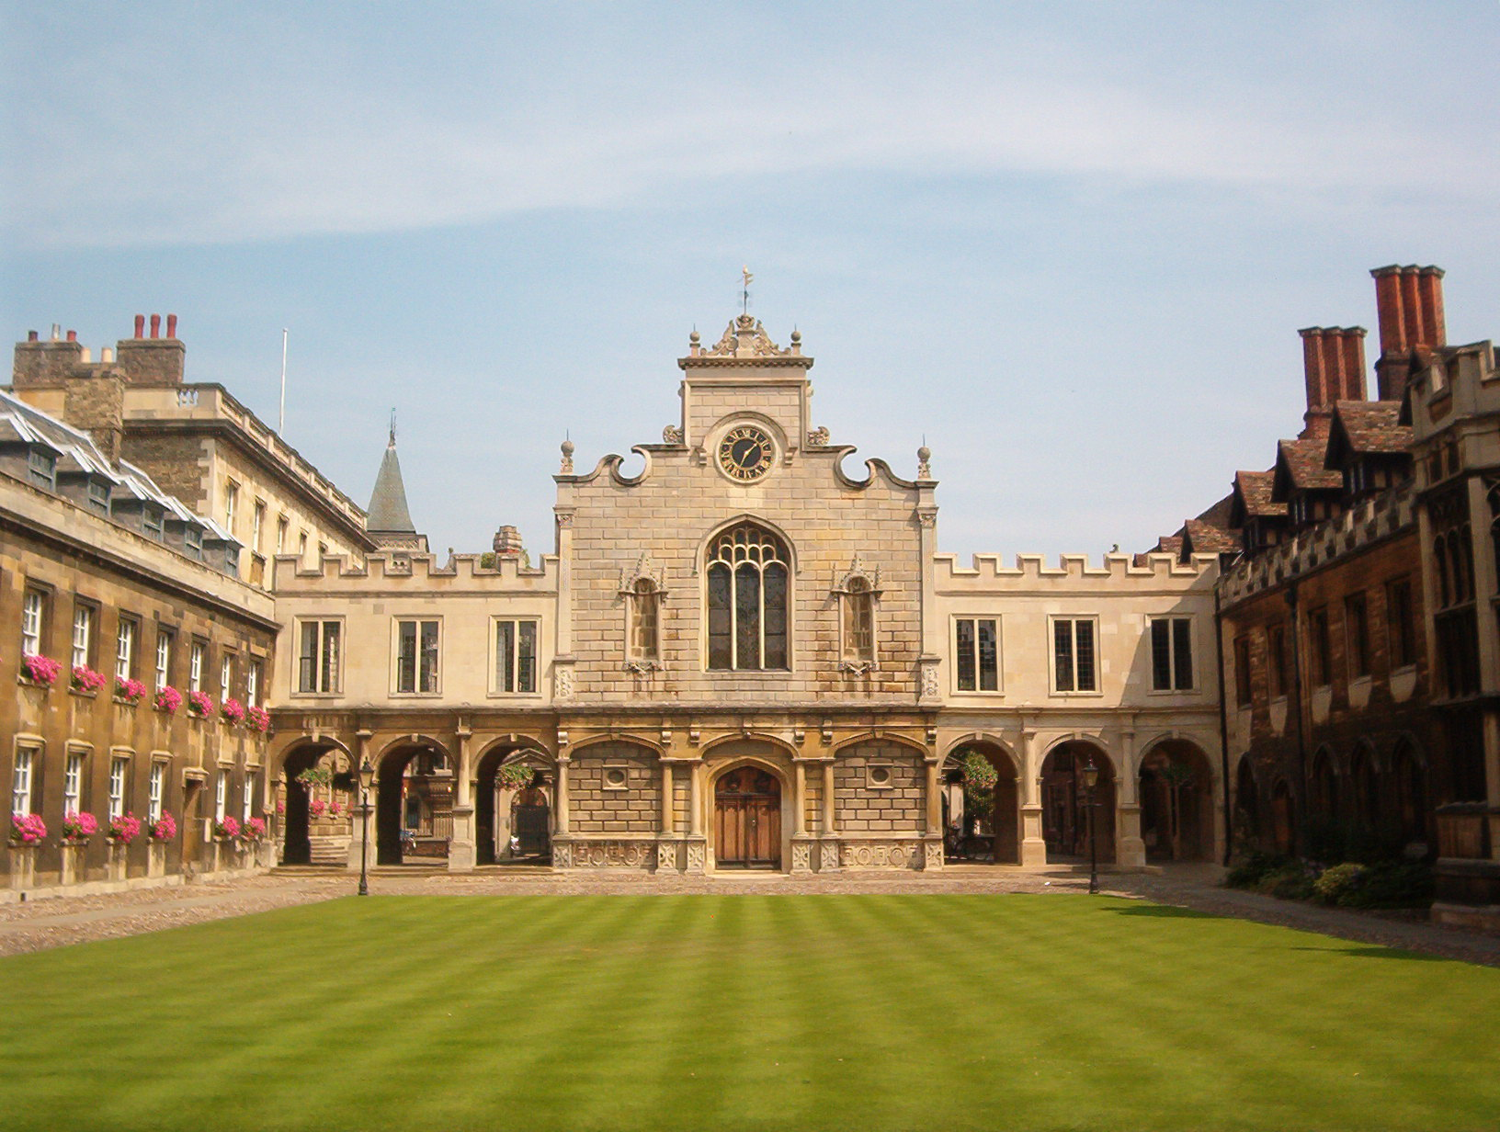
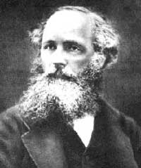
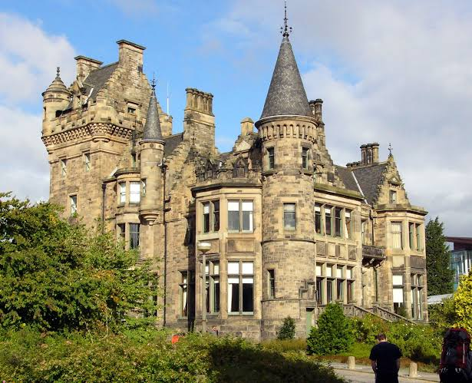
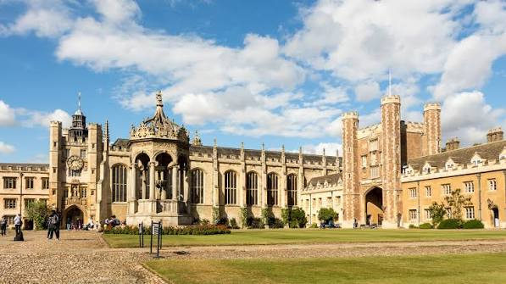
James Clerk Maxwell
Peterhouse, Cambridge
was a Scottish physicist and mathematician
Born: 13 June 1831
Died: 5 November 1879 (at 48)
Education:
University of Edinburgh
Trinity College, Cambridge

Slide 3

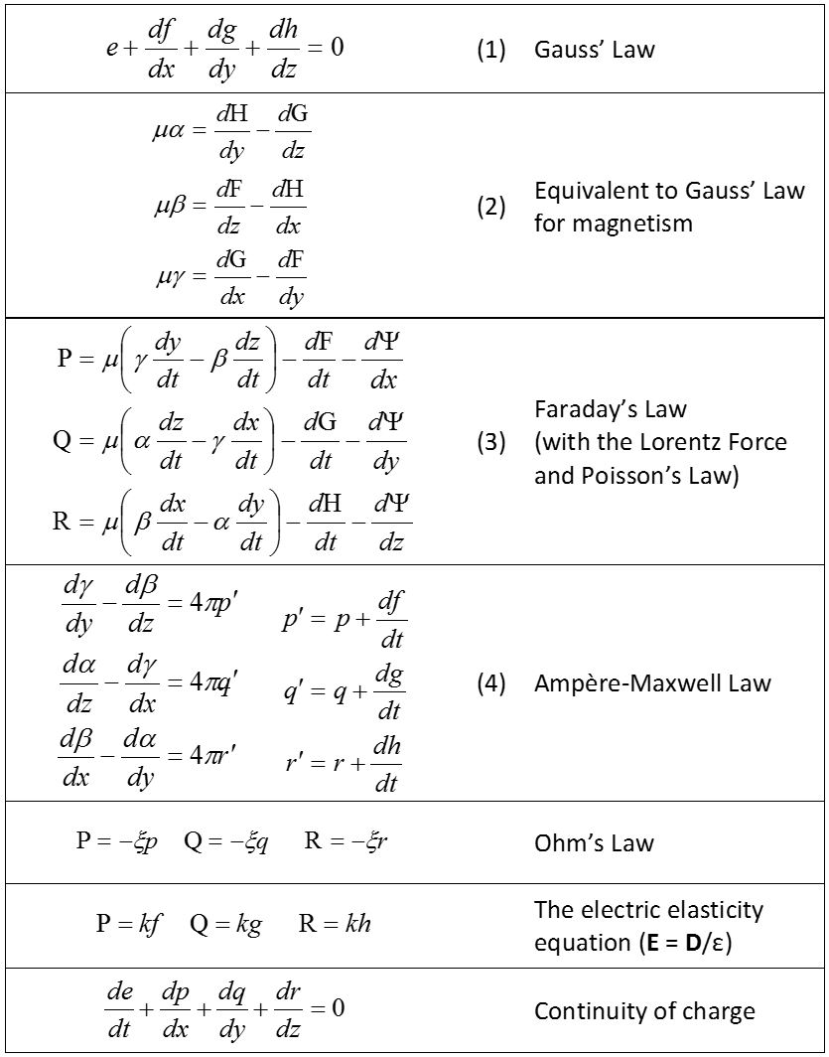
James Clerk Maxwell
Education:
University of Edinburgh
was a Scottish physicist and mathematician
Trinity College, Cambridge
Peterhouse, Cambridge
Discoveries
Electromagnetism
Developed Maxwell’s equations, which describe how electric and magnetic fields interact.
Born: 13 June 1831
Died: 5 November 1879 (at 48)
5
5

Slide 4
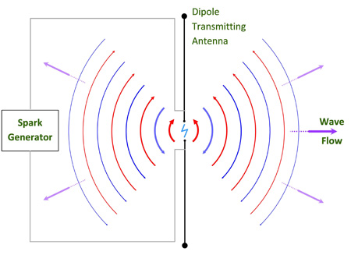

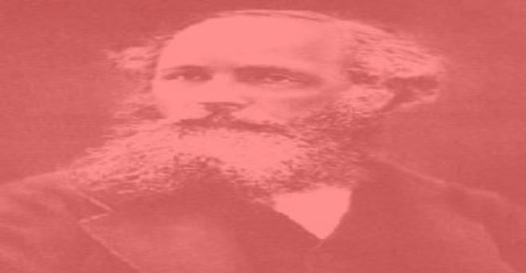
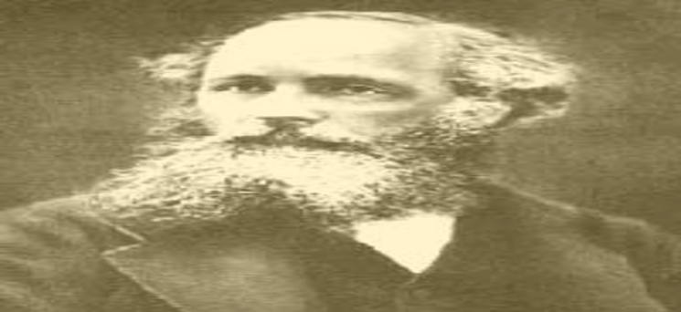
James Clerk Maxwell
Education:
University of Edinburgh
was a Scottish physicist and mathematician
Trinity College, Cambridge
Peterhouse, Cambridge
Discoveries
Electromagnetic Waves
Predicted that changing electric and magnetic fields can travel through space as waves at the speed of light.
+
Born: 13 June 1831
Died: 5 November 1879 (at 48)
+

Slide 5
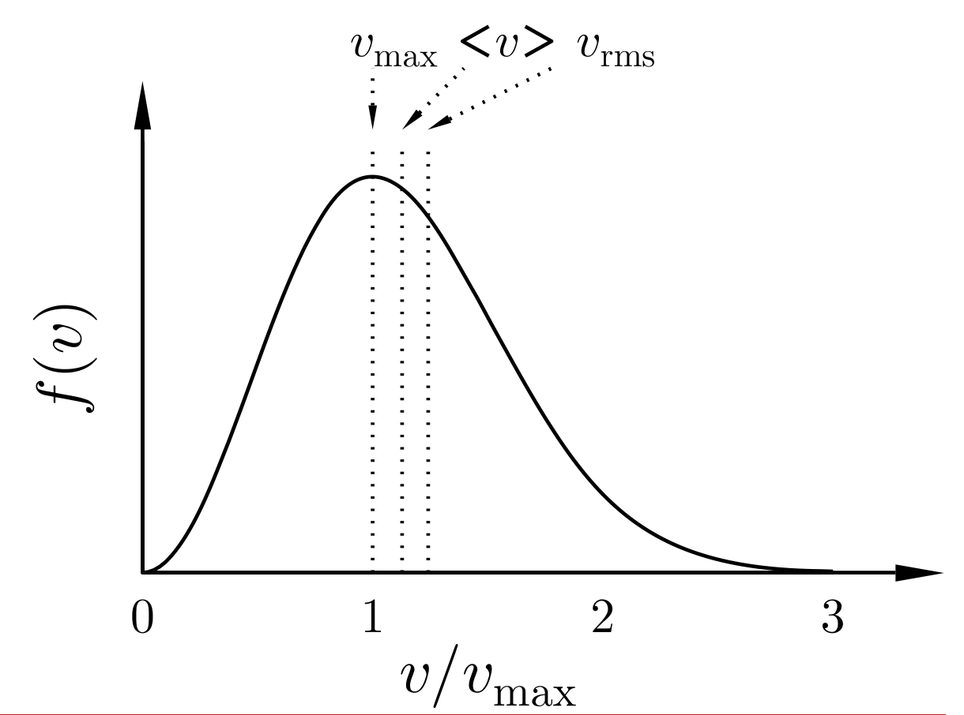


James Clerk Maxwell
Education:
University of Edinburgh
was a Scottish physicist and mathematician
Trinity College, Cambridge
Peterhouse, Cambridge
Discoveries
Kinetic Theory of Gases
Helped explain how the motion of tiny gas molecules relates to temperature and pressure.
+
Born: 13 June 1831
Died: 5 November 1879 (at 48)
+

Slide 6
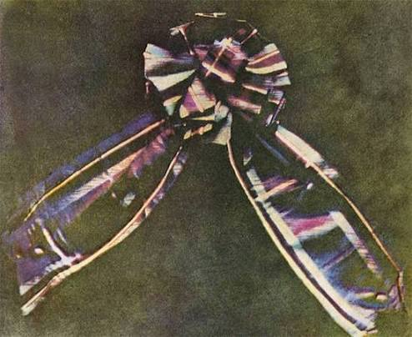
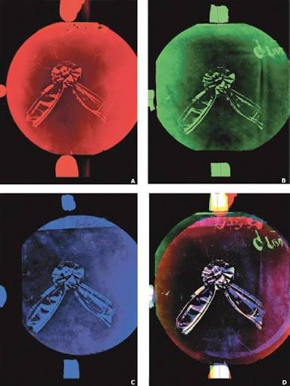
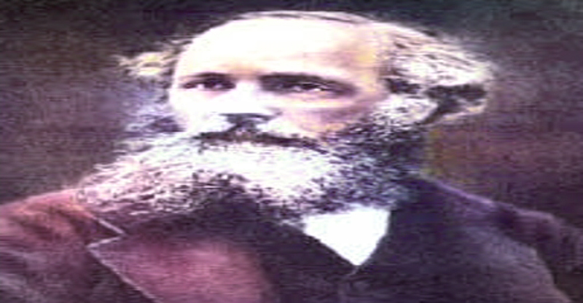
James Clerk Maxwell
Education:
University of Edinburgh
was a Scottish physicist and mathematician
Trinity College, Cambridge
Peterhouse, Cambridge
Discoveries
Color photography
Demonstrated an early color photography technique in 1861 using red, green, and blue color filters.
Born: 13 June 1831
Died: 5 November 1879 (at 48)

Slide 7
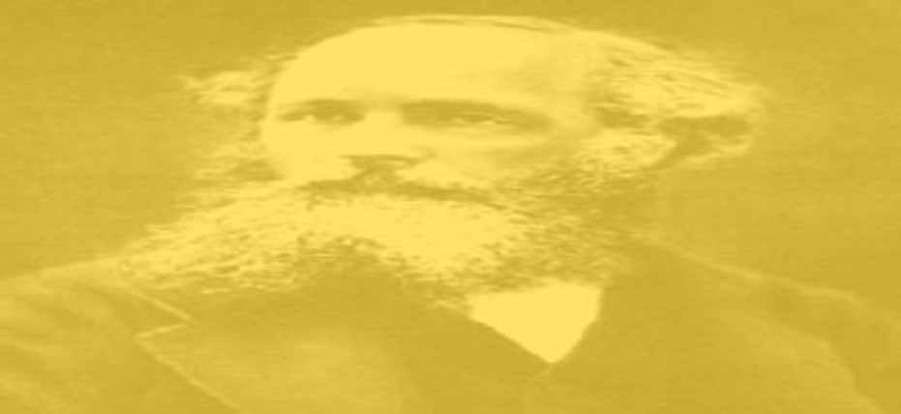

James Clerk Maxwell
Education:
University of Edinburgh
was a Scottish physicist and mathematician
Trinity College, Cambridge
Peterhouse, Cambridge
How did these discoveries help people
James Clerk Maxwell developed equations explaining electromagnetism and proved theoretically that light is an electromagnetic wave. He also helped explain how gas particles move and behave. His discoveries laid the foundation for modern technologies like radio, radar, and wireless communication.
Born: 13 June 1831
Died: 5 November 1879 (at 48)

